Slide 2
ASP.Net
ASP.NET is a web development platform, which provides a programming model, a comprehensive software infrastructure and various services required to build up robust web applications for PC, as well as mobile devices.
ASP.NET is a part of Microsoft .Net platform. ASP.NET applications are compiled codes, written using the extensible and reusable components or objects present in .Net framework. These codes can use the entire hierarchy of classes in .Net framework.
Other Technologies to build Web Applications
PHP
Java
CGI
Perl
Ruby on Rails

Slide 3
Advantages of ASP.Net
Introduced in the year 2002 with .net Framework 1.1.
-Web applications to be installed only in webserver
-Maintenance, support and patches are easier to provide
-Only a browser is required on the client machine to access the web application that can understand HTML.
-Accessible from anywhere, with internet
-Cross Platform
-Web applications work on Client/Server architecture
-On the server side, the web application runs under Microsoft Internet Information Services(IIS)

Slide 4
Web Forms
A web form/page has a code behind and designer files.
-Code behind files has the extension of .aspx.cs or .aspx.vb
-Designer files contains the extension of .aspx.designer.cs or .aspx.designer.vb
-Code behind files contain the code that user writes, where as the designer file contains the auto generated code.
-You should not change the code in the designer file.
-A web form is associated with its code file using the @page directive in the default.aspx file that gets created automatically.

Slide 5
ASP.NET Web Forms Model
ASP.NET web forms extend the event-driven model of interaction to the web applications. The browser submits a web form to the web server and the server returns a full mark-up page or HTML page in response.
HTTP is a stateless protocol. ASP.NET framework helps in storing the information regarding the state of the application, which consists of:
Page state – Contains all the various input fields in the web form.
Session state – Is a collective information from various pages of the same user
ASP. Net session state and the server side infrastructure keeps track of the information collected over a session.

Slide 6
The ASP.NET Component Model
The ASP.NET component model provides various building blocks of ASP.NET pages. Basically it is an object model, which describes:
Server side counterparts of almost all HTML elements or tags, such as <form> and <input>.
Server controls, which help in developing complex user-interface. For example, the Calendar control or the Gridview control.
An ASP.NET web application is made of pages. When a user requests an ASP.NET page, the IIS delegates the processing of the page to the ASP.NET runtime system.
The ASP.NET runtime transforms the .aspx page into an instance of a class, which inherits from the base class page of the .Net framework. Therefore, each ASP.NET page is an object and all its components i.e., the server-side controls are also objects.

Slide 7
Projects and Solutions
A typical ASP.NET application consists of many items: the web content files (.aspx), source files (.cs files), assemblies (.dll and .exe files), data source files (.mdb files), references, icons, user controls and miscellaneous other files and folders. All these files that make up the website are contained in a Solution.
Typically a project contains the following content files:
Page file (.aspx)
User control (.ascx)
Web service (.asmx)
Master page (.master)
Site map (.sitemap)
Website configuration file (.config)

Slide 8
-Web forms live for barely a moment. When a request is received
1. An instance of the requested web form/page is created
2. Events processed
3. Generates the HTML & posts to the client
4. The web form is immediately destroyed.

Slide 9
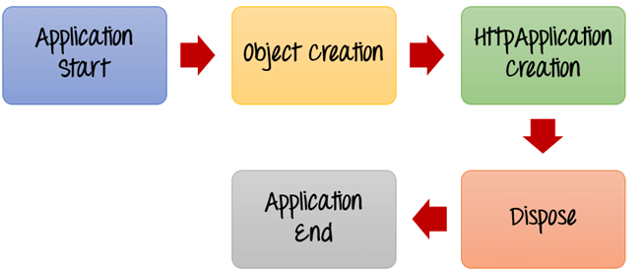
ASP.Net Application & Page Life Cycle

Slide 10
Application Start - The life cycle of an ASP.NET application starts when a request is made by a user. This request is to the Web server for the ASP.Net Application. During this time, there is a method called Application_start which is executed by the web server. Usually, in this method, all global variables are set to their default values.
Object creation - The next stage is the creation of the HttpContext, HttpRequest & HttpResponse by the web server. The HttpContext is just the container for the HttpRequest and HttpResponse objects. The HttpRequest object contains information about the current request, including cookies and browser information. The HttpResponse object contains the response that is sent to the client.

Slide 11
HttpApplication creation - This object is created by the web server. It is this object that is used to process each subsequent request sent to the application. For example, let's assume we have 2 web applications. One is a shopping cart application, and the other is a news website. For each application, we would have 2 HttpApplication objects created. Any further requests to each website would be processed by each HttpApplication respectively.
Dispose - This event is called before the application instance is destroyed. One can use this method to manually release any unmanaged resources.
Application End – This is the final part of the application, where it is finally unloaded from memory.

Slide 12
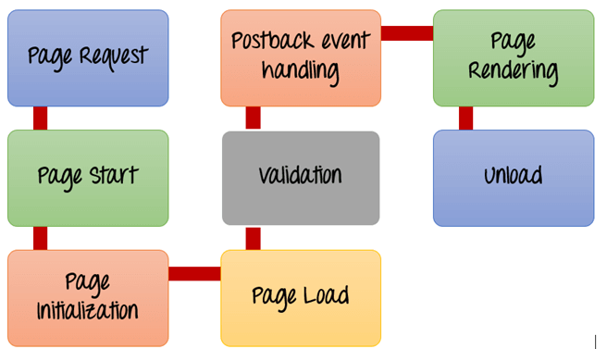
ASP.Net Page Lifecycle

Slide 13
Page Request- This is when the page is first requested from the server. When the page is requested, the server checks if it is requested for the first time. If so, then it needs to compile the page, parse the response and send it across to the user. If it is not the first time the page is requested, the cache is checked to see if the page output exists. If so, that response is sent to the user.
Page Start – During this time, 2 objects, known as the Request and Response object are created. The Request object is used to hold all the information which was sent when the page was requested. The Response object is used to hold the information which is sent back to the user.

Slide 14
Page Initialization – During this time, all the controls on a web page is initialized. So if you have any label, textbox or any other controls on the web form, they are all initialized.
Page Load – This is when the page is actually loaded with all the default values. So if a textbox is supposed to have a default value, that value is loaded during the page load time.
Validation – Sometimes there can be some validation set on the form. For example, there can be a validation which says that a list box should have a certain set of values. If the condition is false, then there should be an error in loading the page.

Slide 15
Postback event handling – This event is triggered if the same page is being loaded again. This happens in response to an earlier event. Sometimes there can be a situation that a user clicks on a submit button on the page. In this case, the same page is displayed again. In such a case, the Postback event handler is called.
Page Rendering – This happens just before all the response information is sent to the user. All the information on the form is saved, and the result is sent to the user as a complete web page.
Unload – Once the page output is sent to the user, there is no need to keep the ASP.net web form objects in memory. So the unloading process involves removing all unwanted objects from memory.

Slide 16
ASP.NET Page Life Cycle Events
Following are the page life cycle events:
PreInit - PreInit is the first event in page life cycle. It checks the IsPostBack property and determines whether the page is a postback. It sets the themes and master pages, creates dynamic controls, and gets and sets profile property values. This event can be handled by overloading the OnPreInit method or creating a Page_PreInit handler.
Init - Init event initializes the control property and the control tree is built. This event can be handled by overloading the OnInit method or creating a Page_Init handler.
InitComplete - InitComplete event allows tracking of view state. All the controls turn on view-state tracking.

Slide 17
LoadViewState - LoadViewState event allows loading view state information into the controls.
LoadPostData - During this phase, the contents of all the input fields are defined with the <form> tag and are processed.
PreLoad - PreLoad occurs before the post back data is loaded in the controls. This event can be handled by overloading the OnPreLoad method or creating a Page_PreLoad handler.
Load - The Load event is raised for the page first and then recursively for all child controls. The controls in the control tree are created. This event can be handled by overloading the OnLoad method or creating a Page_Load handler.

Slide 18
LoadComplete - The loading process is completed, control event handlers are run, and page validation takes place. This event can be handled by overloading the OnLoadComplete method or creating a Page_LoadComplete handler
PreRender - The PreRender event occurs just before the output is rendered. By handling this event, pages and controls can perform any updates before the output is rendered.
PreRenderComplete - As the PreRender event is recursively fired for all child controls, this event ensures the completion of the pre-rendering phase.

Slide 19
SaveStateComplete - State of control on the page is saved. Personalization, control state and view state information is saved. The HTML markup is generated. This stage can be handled by overriding the Render method or creating a Page_Render handler.
UnLoad - The UnLoad phase is the last phase of the page life cycle. It raises the UnLoad event for all controls recursively and lastly for the page itself. Final cleanup is done and all resources and references, such as database connections, are freed. This event can be handled by modifying the OnUnLoad method or creating a Page_UnLoad handler.

Slide 20
Inline Code and Code Behind
Inline Code
Inline Code refers to the code that is written inside an ASP.NET Web Page that has an extension of .aspx. It allows the code to be written along with the HTML source code using a <Script> tag. It's major point is that since it's physically in the .aspx file it's deployed with the Web Form page whenever the Web Page is deployed.
Code Behind
Code Behind refers to the code for an ASP.NET Web page that is written in a separate class file that can have the extension of .aspx.cs or .aspx.vb depending on the language used. Here the code is compiled into a separate class from which the .aspx file derives. You can write the code in a separate .cs or .vb code file for each .aspx page. One major point of Code Behind is that the code for all the Web pages is compiled into a DLL file that allows the web pages to be hosted free from any Inline Server Code.

Slide 21
All web forms are basically instances of the ASP.NET Page class. The page class has the following extremely useful properties that correspond to intrinsic objects:
Session
Application
Cache
Request
Response
Server
User
Trace

Slide 22
Server Controls
Standard Controls: The ASP.NET standard controls are a group of controls that enable you to create forms in which users can type or select information before a page is posted back to the server. Standard controls are Web server controls that inherit from the Control class. Examples of Web server controls include the TextBox, Image, and AdRotator controls. The information in this topic describes configuration and coding best practices that will help you improve the security of standard controls.
AdRotator Control. The AdRotator control displays advertisements defined in an advertisement file, which by default is an XML file. ...
BulletedList, CheckBoxList, RadioButtonList, DropDownList, ListBox. ...
Calendar Control. ...
FileUpload Control. ...
HiddenField Control. ...
Hyperlink. ...
Image and ImageMap Controls. ...
ImageButton Control.

Slide 23
Validation Controls: ASP.NET validation controls validate the user input data to ensure that useless, unauthenticated, or contradictory data don't get stored.
ASP.NET provides the following validation controls:
RequiredFieldValidator
RangeValidator
CompareValidator
RegularExpressionValidator
CustomValidator
ValidationSummary

Slide 24
Data Controls: The Controls having DataSource Property are called Data Controls in ASP.NET.
DataList and DetailsView are Data Controls, means both are used to Display and Manipulate Data.
User Controls: In addition to using Web server controls in your ASP.NET Web pages, you can create your own custom, reusable controls using the same techniques you use for creating ASP.NET Web pages. These controls are called user controls.
A user control is a kind of composite control that works much like an ASP.NET Web page—you can add existing Web server controls and markup to a user control, and define properties and methods for the control. You can then embed them in ASP.NET Web pages, where they act as a unit.

Slide 25
Navigation Controls: You can use ASP.NET site-navigation features to provide a consistent way for users to navigate your site. As your site grows, and as you move pages around in the site, it can become difficult to manage all of the links. ASP.NET site navigation enables you to store links to all of your pages in a central location, and render those links in lists or navigation menus on each page by including a specific Web server control.
Site maps
ASP.NET controls
Programmatic control .
Access rules
Custom site-map providers

